Slide 1




Text
NEXT GEN EMPLOYABILITY PROGRAM
Creating a future-ready workforce
Team Members
College Name
Student Name :Nivetha V
Student ID :au511321104064
5113 - Kingston Engineering College

Slide 2

CAPSTONE PROJECT SHOWCASE
Project Title
Building Bus Reservation System using Python and Django
Abstract | Problem Statement | Project Overview | Proposed Solution | Technology Used | Modelling & Results | Conclusion

Slide 3
Abstract
The Bus Reservation System is a comprehensive web application designed to automate the process of booking bus tickets online. Developed using Python and the Django framework.
Key features:
User login
Registration
Find Bus
See Bookings
Cancell Booking
Technical overview:
Frontend: HTML, CSS, and JavaScript.
Backend: Python and Django.
Database: SQLite for development.
Security
Source :

Slide 4
Problem Statement
Building Bus Reservation System using Python and Django
The Bus Reservation System project addresses the need for a digital solution to streamline the process of booking bus tickets, offering a user-friendly interface for passengers and an efficient management platform for bus service operators.
It aims to eliminate the complexities and inefficiencies of traditional ticket booking methods, facilitating easy search, selection, and booking of bus seats online while ensuring secure transactions and real-time seat allocation.
Source :

Slide 5
Project Overview
Objective:
The primary objective of this project is to provide a seamless and efficient online booking experience, reducing the time and effort required to reserve bus seats. It aims to digitalize the traditional booking system, making it more accessible, reliable, and user-friendly for passengers, while also providing bus operators with a powerful tool to manage bookings, schedules, and customer interactions more effectively.
Key features:
User login
Registration
Find Bus
See Bookings
Cancell Booking
Technical overview:
Frontend: HTML, CSS, and JavaScript.
Backend: Python and Django.
Database: SQLite for development.
Security
Source :

Slide 6
Proposed Solution
.
The proposed solution for building a Bus Reservation System (BRS) harnesses the robust capabilities of Python and Django to create a scalable, secure, and user-centric online platform.
Core Components
Web Application Architecture
Dynamic Bus Listing and Search Functionality
Real-time Seat Selection and Reservation
Payment Integration
Admin Dashboard for Operators
Feedback and Support System
Technical Stack
Backend Framework: Django, for its robustness, security features, and comprehensive ORM.
Frontend Technologies: HTML5, CSS3, and JavaScript, along with Django Templates for dynamic content rendering.
Database: PostgreSQL for production due to its scalability, with SQLite for development purposes.
Source :

Slide 7
Security Measures: Utilization of Django's security best practices, including HTTPS enforcement, user authentication, input validation, and regular dependency updates to mitigate vulnerabilities.
Implementation Strategy
Phase 1 - Planning and Design:
Requirements analysis with stakeholders.
System design, including database schema and application architecture.
Phase 2 - Development:
Incremental development of application components following Agile methodologies.
Continuous integration and testing to ensure functionality and performance.
Phase 3 - Testing and Deployment:
Comprehensive testing, including unit tests, integration tests, and user acceptance testing (UAT).
Deployment to a production environment, with considerations for scalability and security.
Source :

Slide 8
Phase 4 - Maintenance and Upgrades
Regular system monitoring, user feedback collection, and performance analysis.
Iterative updates and feature enhancements based on user feedback and technological advancements.
By building this system with Python and Django, the solution not only promises to improve the user experience for passengers but also offers bus operators a powerful tool to streamline their operations, ultimately leading to increased satisfaction and business growth.
Source :

Slide 9


Technology Used
Front-end
Back-end
Source :

Slide 10
Modelling & Results
Database Schema:
User Model
Bus Model
Route Model
Schedule Model
Booking Mode
Application Architecture:
Django Model-View-Template (MVT) pattern.
Views
Models
Templates
Result:
User Interface
Functionality
Performance
Scalability
Source :

Slide 11
Homepage
The homepage of a Bus Reservation System built with Python and Django serves as the gateway to the application, setting the tone for the user experience. It's designed to be welcoming, informative, and intuitive, allowing both new and returning users to navigate the service easily.
Key Components:
Navigation Bar: Present at the top of the page, it includes links to various parts of the website such as Home, About Us, Contact, Log In/Sign Up, and Dashboard (for logged-in users).
Search Panel
Featured Routes
Testimonials
Call to Action (CTA) Buttons
User-Friendly Interface

Slide 12
About-Us-Page
Key Components:
Company Overview
Team Members
Our Values
Why Choose Us
Customer Testimonials
Contact Information
FAQs
Design Principles:
Professional and Trustworthy
Clear and Concise
Visual Elements
Functionality:
Interactive Elements
Social Proof
Responsive Design

Slide 13
Service-Page
Key Components:
Service Offerings
Features and Benefits
Booking Process Overview
Customization Options
Safety and Security Measures
Customer Support
Design Principles:
Professional and Trustworthy
Clear and Concise
Visual Elements
Functionality:
Interactive Elements
Social Proof
Responsive Design

Slide 14
Departments-Page
Key Components
Department Descriptions Roles and Responsibilities
Contact Information Organizational Structure Team Members
Functionality
Interactive Elements Social Proof Responsive Design
Technologies Used
HTML5 and CSS3 JavaScript Django Templating

Slide 15
Blog-Page
Key Components:
Article Listings
Individual Article Pages
Categories and Tags
Author Information
Comments Section
Search Functionality
Featured Articles
Design Principles:
Clean and Engaging Layout
Consistent Branding
Responsive Design
User-Friendly Navigation
Functionality:
Content Management System (CMS)
Dynamic Content Rendering
User Interaction

Slide 16
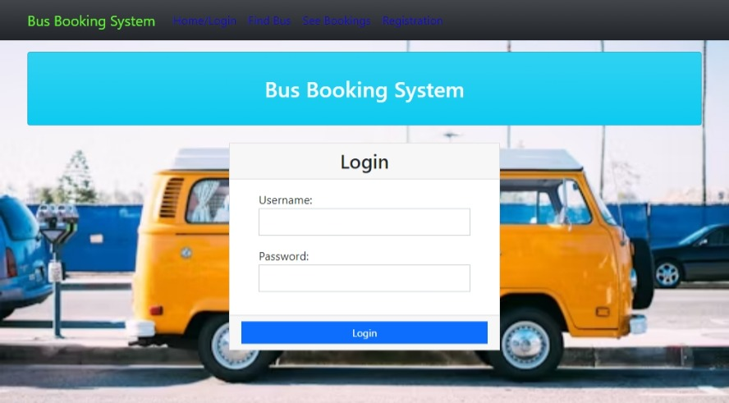
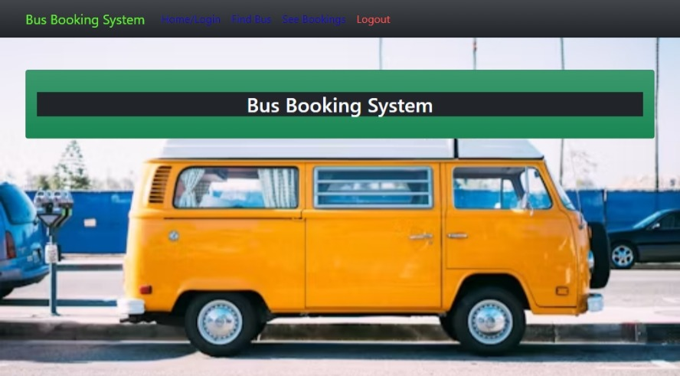
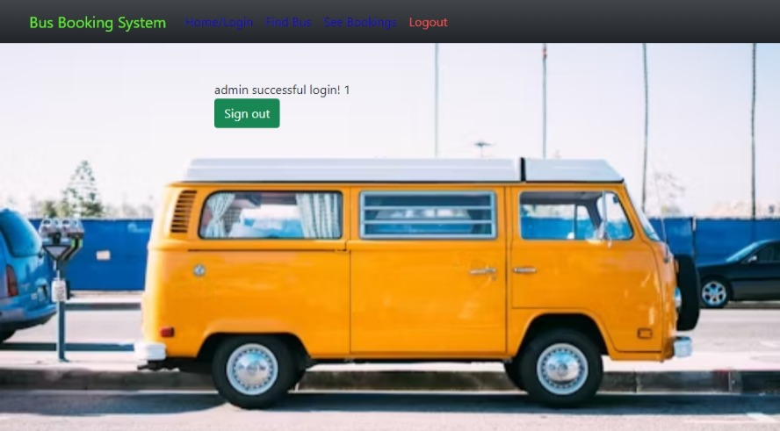
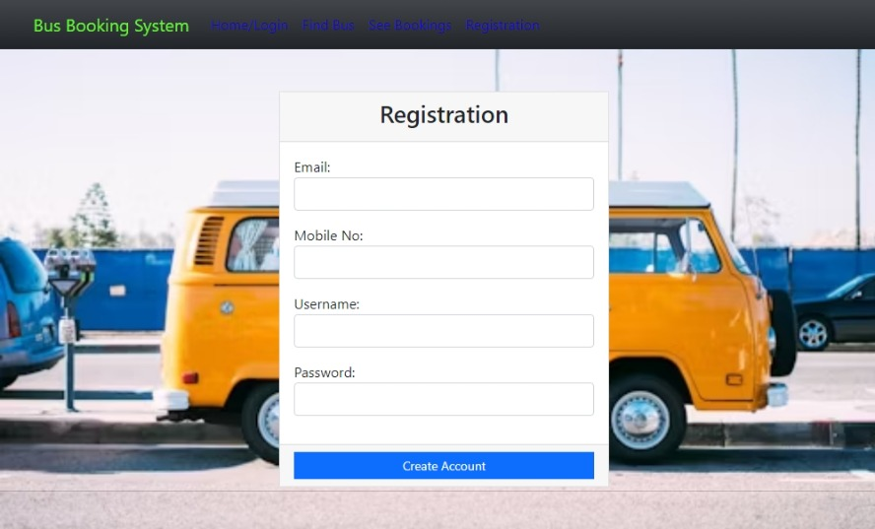
Screenshots

Slide 17
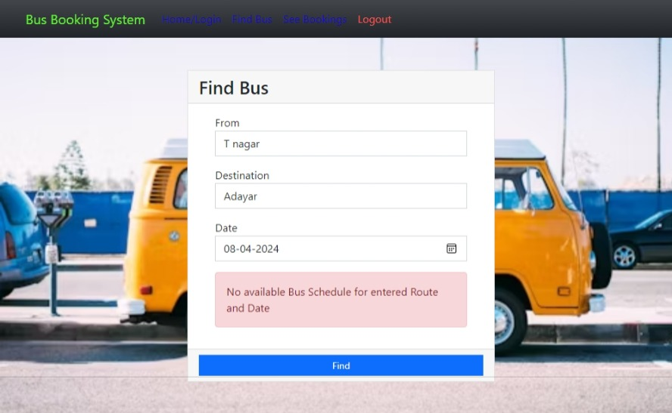
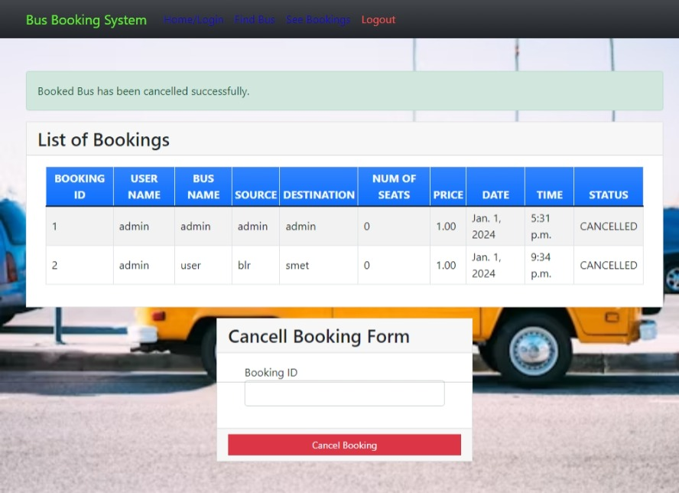
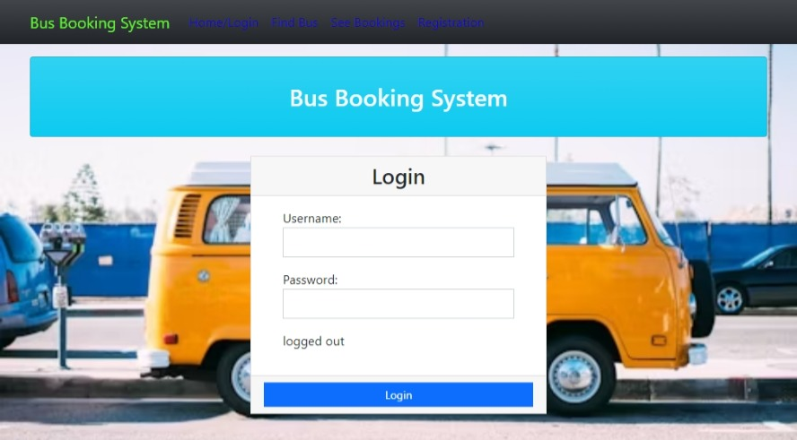

Slide 18
Future Enhancements:
Mobile App Development
Intelligent Seat Allocation
Dynamic Pricing Integration with Public Transit Systems
Enhanced Customer Support
Accessibility Features
Multi-Language Support Social Integration
Advanced Analytics and Reporting
Environmental Sustainability Initiatives
Virtual Reality (VR) Tours
Integration with Loyalty Programs
These future enhancements can help elevate the Bus Reservation System to the next level, providing added value to users, improving operational efficiency, and staying ahead of the competition in the dynamic travel industry landscape.

Slide 19
Conclusion
Building a Bus Reservation System using Python and Django offers a robust, scalable, and user-friendly solution to streamline the process of booking bus tickets for passengers while providing efficient management tools for bus operators. Through the utilization of Django's powerful framework and Python's versatility, developers can create a feature-rich application that addresses the complexities of traditional booking systems and meets the evolving needs of the transportation industry.
Overall, the Bus Reservation System built with Python and Django represents a comprehensive solution that improves efficiency, enhances user experience, and drives growth in the transportation industry. With continuous refinement and adaptation to user feedback and market dynamics, the system can remain a reliable and indispensable resource for travelers and operators alike.
Source :

Slide 20
Thank You!
Notes:
Thank You !!

